Slide 1
WHAT IS LIFF?
梓育

Slide 2
LIFF
LIFF 全名是 LINE Front-end Framework，一個可以在 LINE app 內運作的 web app 平台，可以在對話視窗中，不需要另外加入 bot 就直接使用。
簡單來說要建立一個 LIFF web app ，需要下面幾個步驟：
建立一個 Message API 權限的 LINE channel。
取得 channel 的 token，用它來註冊 LIFF web app 取得 LIFF app id。
寫 code阿不然要幹嘛。

Slide 3
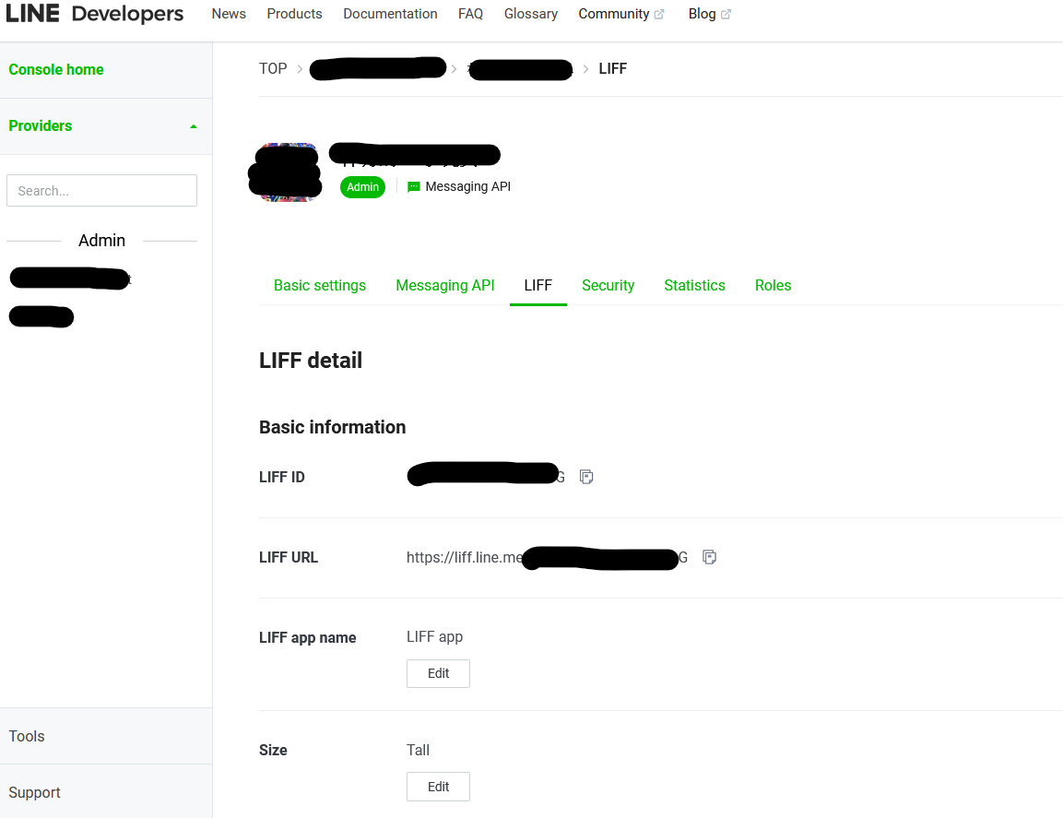
channel token 可以從 https://developers.line.biz/console/channel 中找到你的LIFF APP後直接拿到 LIFF app id。

Slide 4
LIFF 可以讓開發者很快地實作出與使用者互動的 web app，從使用者端得到 input 後，把處理完的結果馬上顯示到當下的聊天視窗中。
Document: V1: https://developers.line.biz/en/docs/liff/registering-liff-apps LIFF101: https://github.com/line/line-liff-starter V2: https://developers.line.biz/en/reference/liff

Slide 5
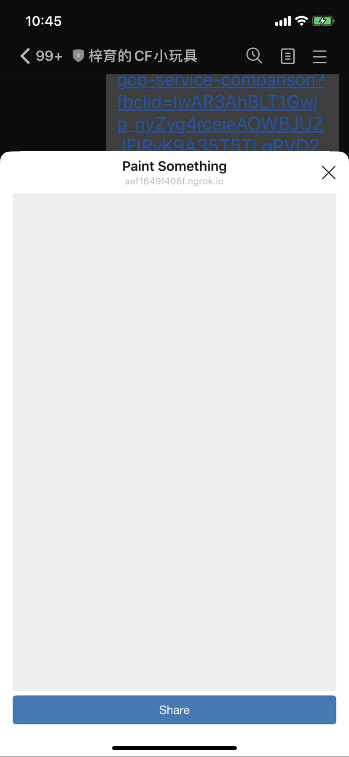
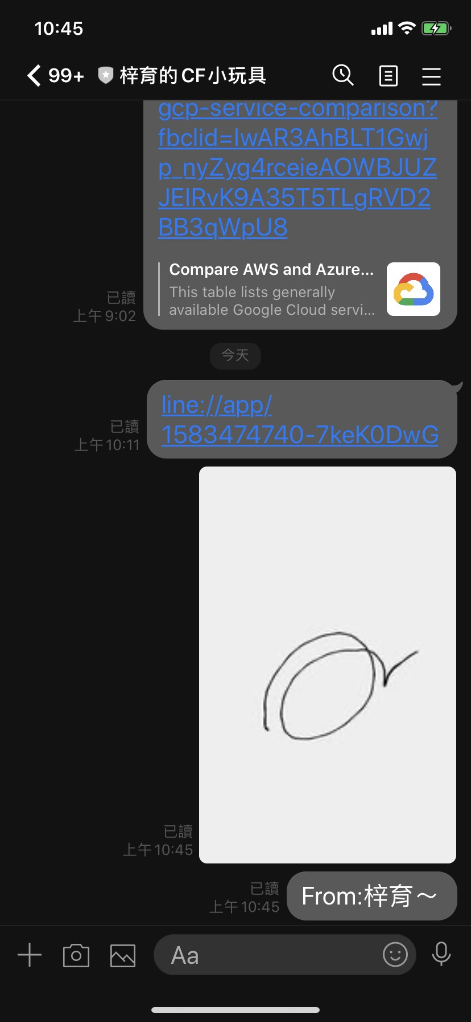
Demo
Notes:
https://engineering.linecorp.com/ja/blog/detail/299/

Slide 6
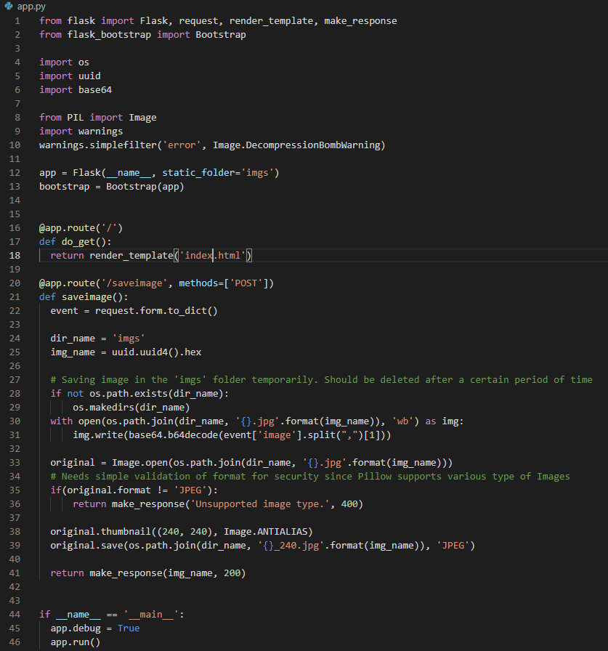
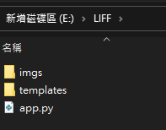
Demo
Notes:
from flask import Flask, request, render_template, make_response
from flask_bootstrap import Bootstrap
import os
import uuid
import base64
from PIL import Image
import warnings
warnings.simplefilter('error', Image.DecompressionBombWarning)
app = Flask(__name__, static_folder='imgs')
bootstrap = Bootstrap(app)
@app.route('/')
def do_get():
return render_template('index.html')
@app.route('/saveimage', methods=['POST'])
def saveimage():
event = request.form.to_dict()
dir_name = 'imgs'
img_name = uuid.uuid4().hex
# Saving image in the 'imgs' folder temporarily. Should be deleted after a certain period of time
if not os.path.exists(dir_name):
os.makedirs(dir_name)
with open(os.path.join(dir_name, '{}.jpg'.format(img_name)), 'wb') as img:
img.write(base64.b64decode(event['image'].split(",")[1]))
original = Image.open(os.path.join(dir_name, '{}.jpg'.format(img_name)))
# Needs simple validation of format for security since Pillow supports various type of Images
if(original.format != 'JPEG'):
return make_response('Unsupported image type.', 400)
original.thumbnail((240, 240), Image.ANTIALIAS)
original.save(os.path.join(dir_name, '{}_240.jpg'.format(img_name)), 'JPEG')
return make_response(img_name, 200)
if __name__ == '__main__':
app.debug = True
app.run()

Slide 7
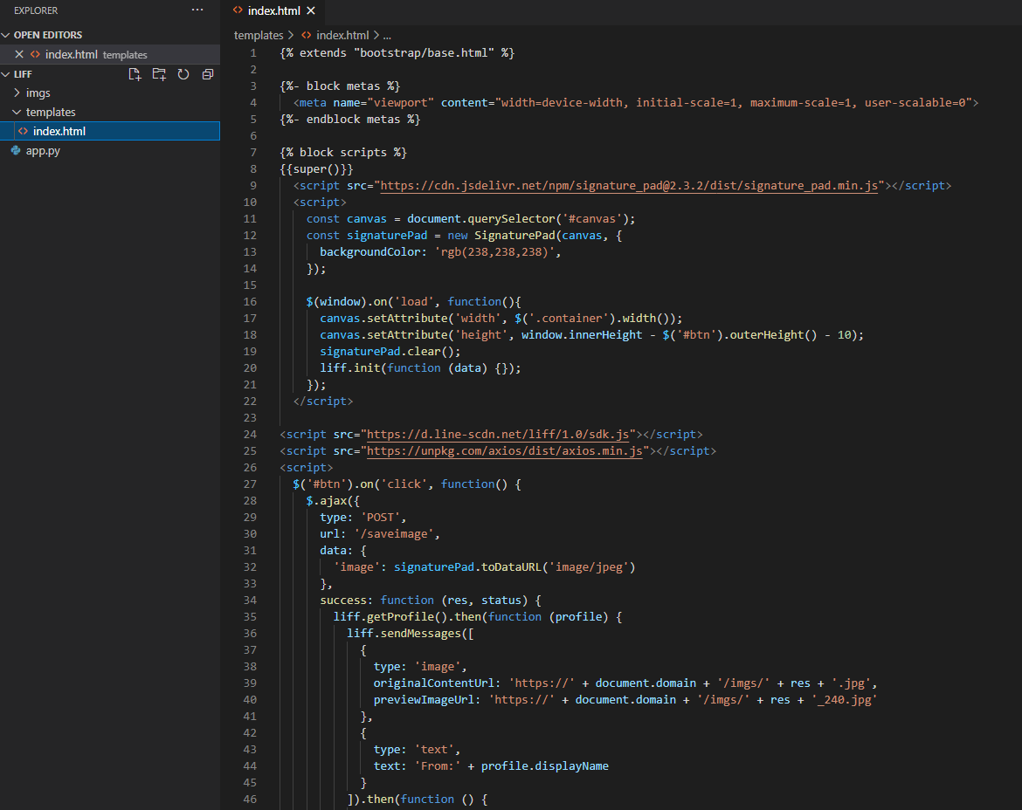
Notes:
{% extends "bootstrap/base.html" %}
{%- block metas %}
<meta name="viewport" content="width=device-width, initial-scale=1, maximum-scale=1, user-scalable=0">
{%- endblock metas %}
{% block scripts %}
{{super()}}
<script src="https://cdn.jsdelivr.net/npm/signature_pad@2.3.2/dist/signature_pad.min.js"></script>
<script>
const canvas = document.querySelector('#canvas');
const signaturePad = new SignaturePad(canvas, {
backgroundColor: 'rgb(238,238,238)',
});
$(window).on('load', function(){
canvas.setAttribute('width', $('.container').width());
canvas.setAttribute('height', window.innerHeight - $('#btn').outerHeight() - 10);
signaturePad.clear();
liff.init(function (data) {});
});
</script>
<script src="https://d.line-scdn.net/liff/1.0/sdk.js"></script>
<script src="https://unpkg.com/axios/dist/axios.min.js"></script>
<script>
$('#btn').on('click', function() {
$.ajax({
type: 'POST',
url: '/saveimage',
data: {
'image': signaturePad.toDataURL('image/jpeg')
},
success: function (res, status) {
liff.getProfile().then(function (profile) {
liff.sendMessages([
{
type: 'image',
originalContentUrl: 'https://' + document.domain + '/imgs/' + res + '.jpg',
previewImageUrl: 'https://' + document.domain + '/imgs/' + res + '_240.jpg'
},
{
type: 'text',
text: 'From:' + profile.displayName
}
]).then(function () {
liff.closeWindow();
}).catch(function (error) {
window.alert('Error sending message: ' + error.message);
});
}).catch(function (error) {
window.alert("Error getting profile: " + error.message);
});
},
error: function (res) {
window.alert('Error saving image: ' + res.status);
}
});
});
</script>
{% endblock %}
{% block title %}Paint Something{% endblock %}
{% block content %}
<div class="container">
<canvas id="canvas"></canvas>
<button id="btn" type="button" class="btn btn-primary btn-block">Share</button>
</div>
{% endblock %}

